Slide 1
Maxima and Minima
Nazmul Kader Chowdhury

Slide 2
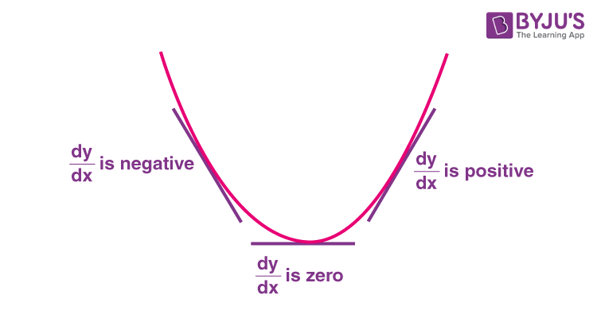




Slide 3
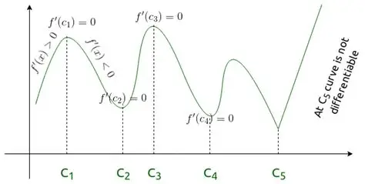

Slide 4
$${f\left(x\right)=x}^{3}−3x^{2}−45x+13$$
Check whether the function is increasing or decreasing at x=5
Check whether the function is increasing or decreasing at x=7
c) Find the value of x where maximum value can be found.
d)Find the interval where the function is increasing
e) Find the interval where the function is decresing

Slide 5
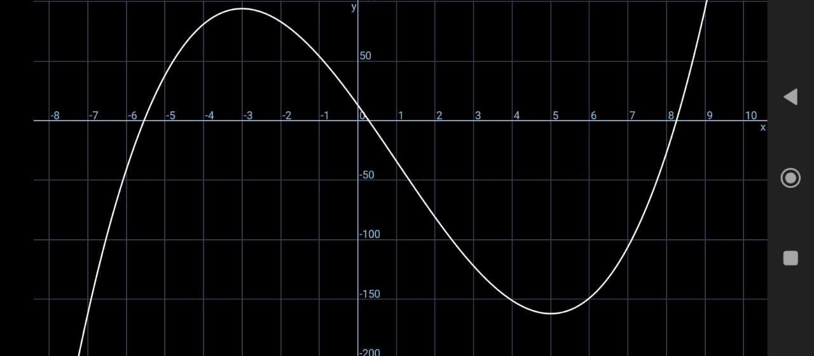

Slide 6
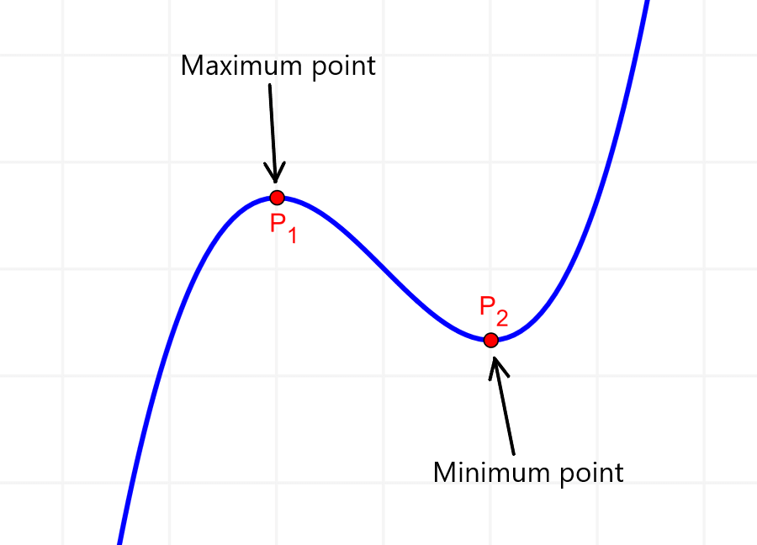

Slide 7
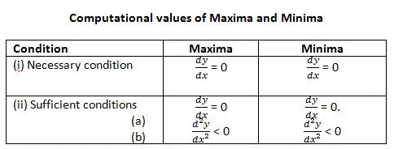

Slide 8
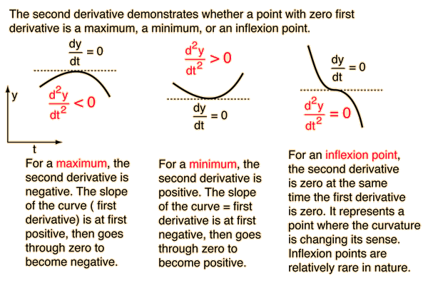

Slide 9
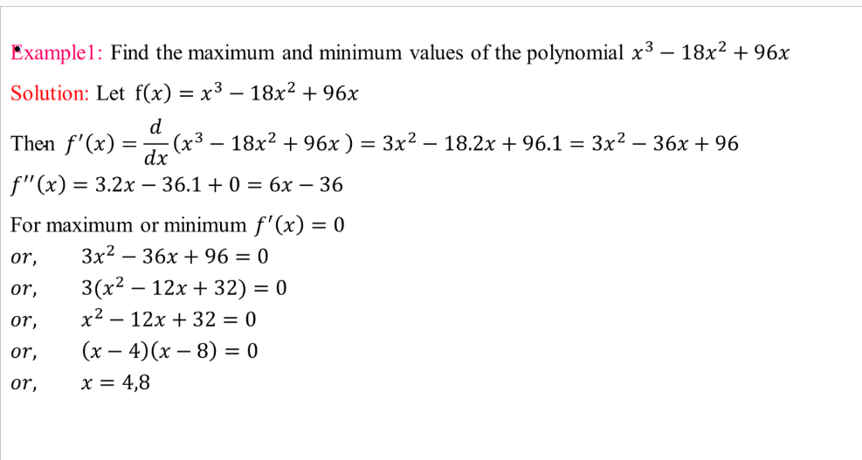

Slide 10
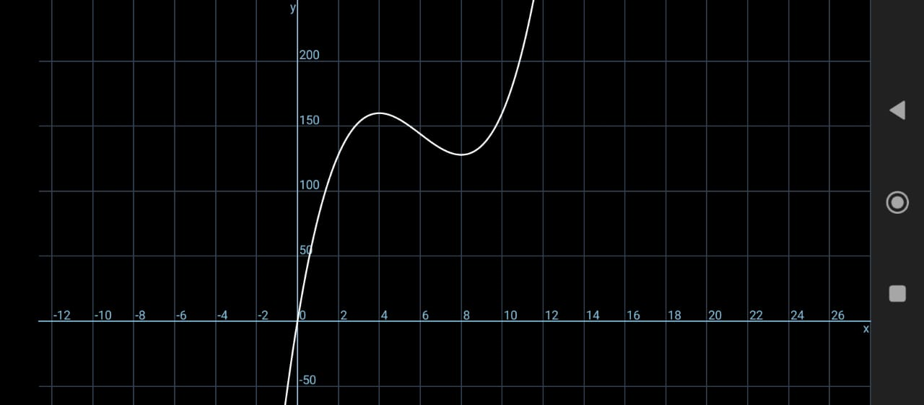

Slide 11
